Slide 1



Surveys and training activities of Intellectual Output 1 some evidences

Slide 2

IO 1 – Main Activities
2 meetings on presence (February 2020) with students: discussion about stereotypes, gender violence social image, causes of violence episode.
2 on line meetings with students, 1 on line meeting teachers and 1 on line meeting with parents aimed to describe the results of the questionnaire.
Planned a plenary session for each school. Planned phase for “control group”
Handbook
Results of the questionnaires
Teachers
School 1 (Augusto Lyceum): 8
School 2 (Mamiani Lyceum); 6
Total teachers: 14
Students
School 1 (Augusto Lyceum): 20
School 2 (Mamiani Lyceum); 25
Total teachers: 45
Parents
School 1 (Augusto Lyceum): 26
School 2 (Mamiani Lyceum); 31
Total teachers: 57

Slide 3
Profile of students, teachers and parents
Students
Teachers

Slide 4
Students’ statement

Slide 5
Teachers’ statement

Slide 6
Parents’statement

Slide 7

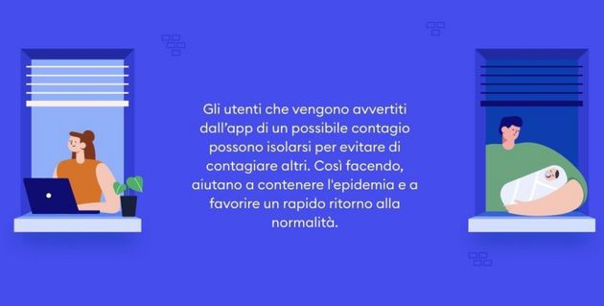
Still stereotypes in Italy….
IMMUNI APP using against COVID19

Slide 8
Some remark regarding gender stereotype
“The most important role of a woman is to take care of her house and family”
Eurobarometer, 2017

Slide 9
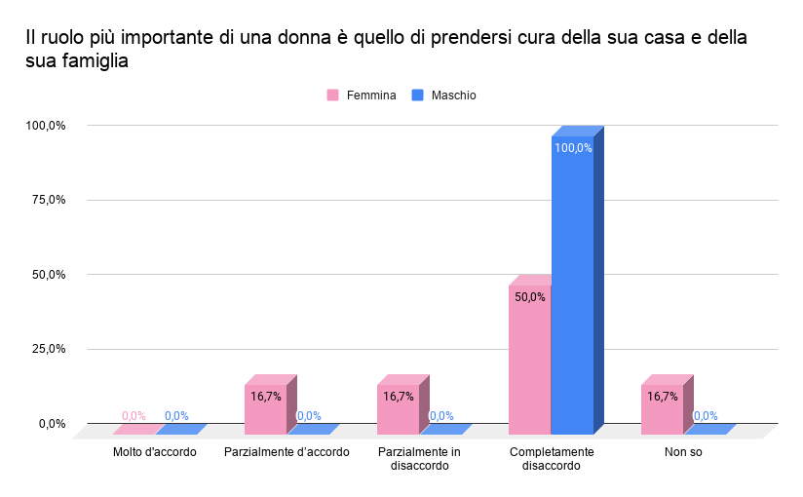
Some remark regarding gender stereotype: comparison between teachers and student
“The most important role of a woman is to take care of her house and family”
What the teachers think…

Slide 10
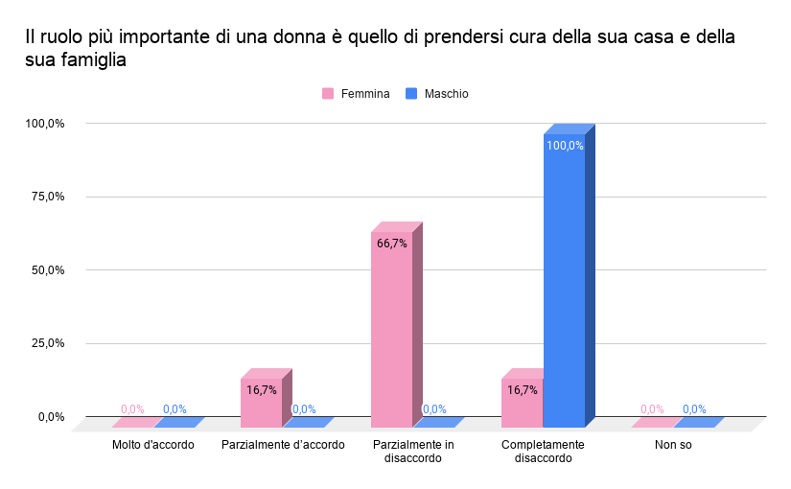
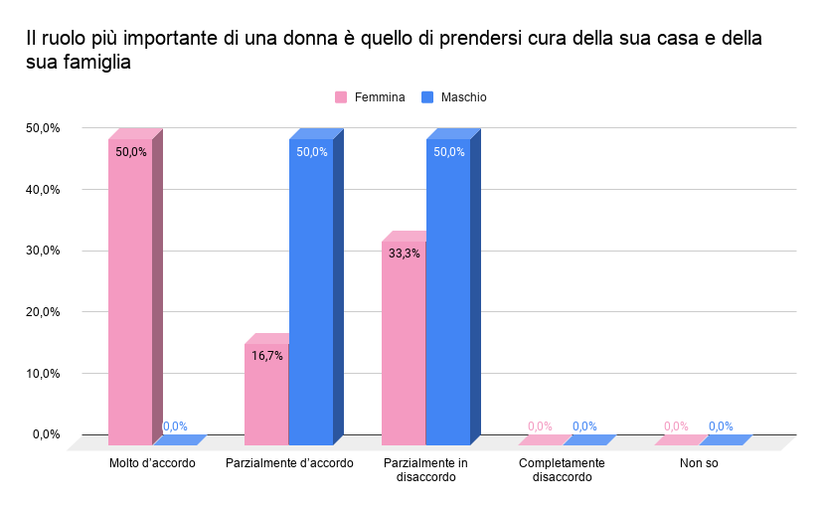
Some remark regarding gender stereotype: comparison between teachers and student
“The most important role of a woman is to take care of her house and family”
Female
Male
What the teachers think about the students’ answers

Slide 11
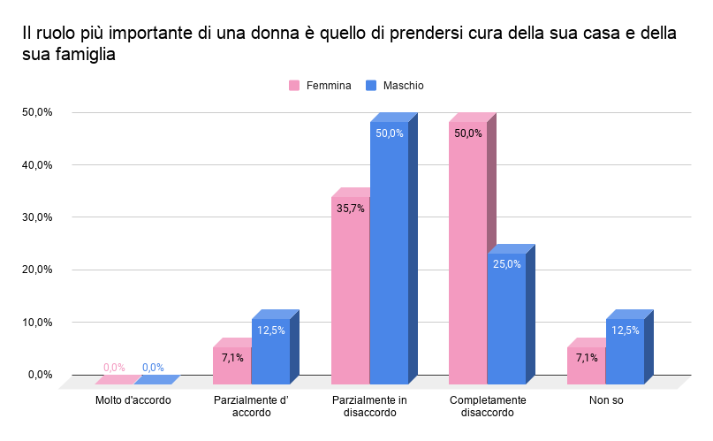
Some remark regarding gender stereotype: comparison between teachers and student
“The most important role of a woman is to take care of her house and family”
What the students answer

Slide 12
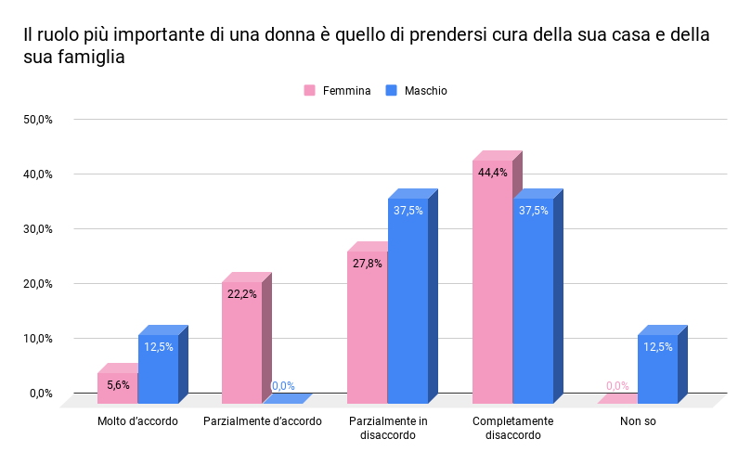
Some remark regarding gender stereotype: comparison between parents and student
“The most important role of a woman is to take care of her house and family”
What the parents think

Slide 13
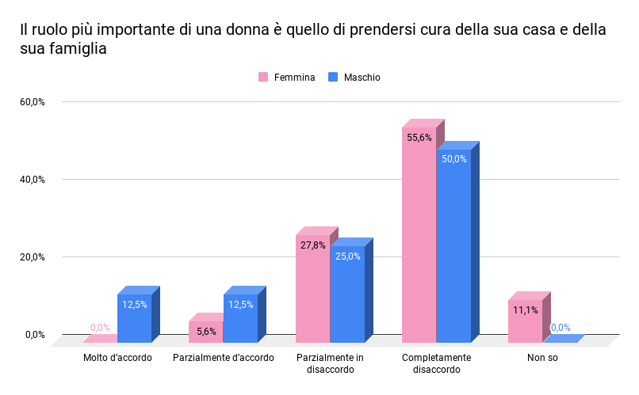
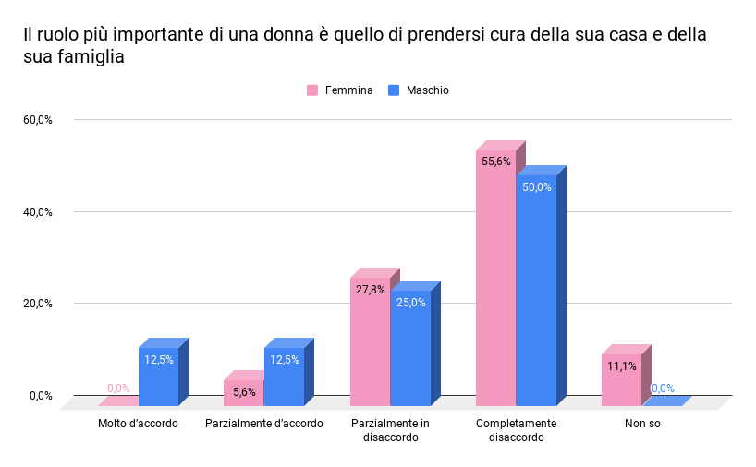
Some remark regarding gender stereotype: comparison between parents and students
“The most important role of a woman is to take care of her house and family”
Female
Male
What the parents think about the students’ answers

Slide 14
Some remarks regarding gender stereotype
“It is acceptable for men to cry”
Eurobarometer, 2017

Slide 15
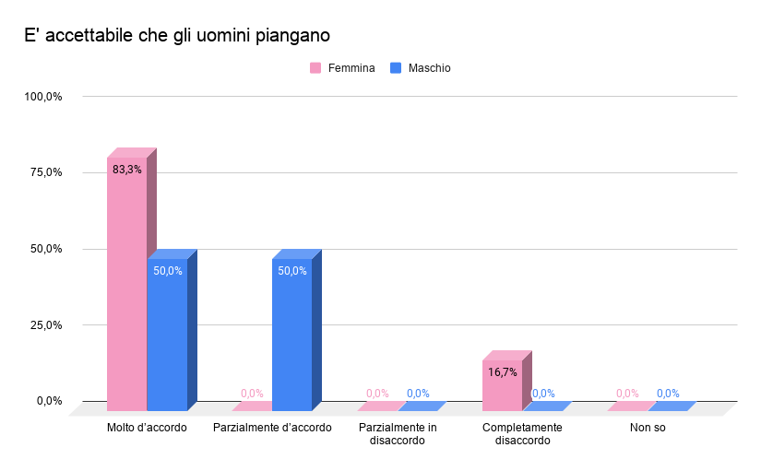
Some remark regarding gender stereotype: comparison between teachers and student
“It is acceptable for men to cry”
What the teachers think…

Slide 16
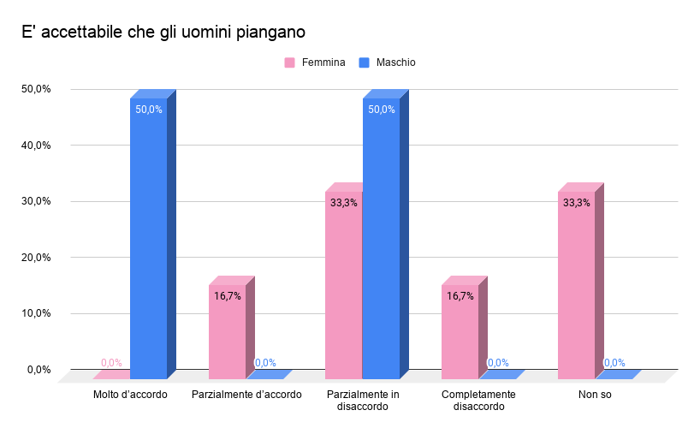
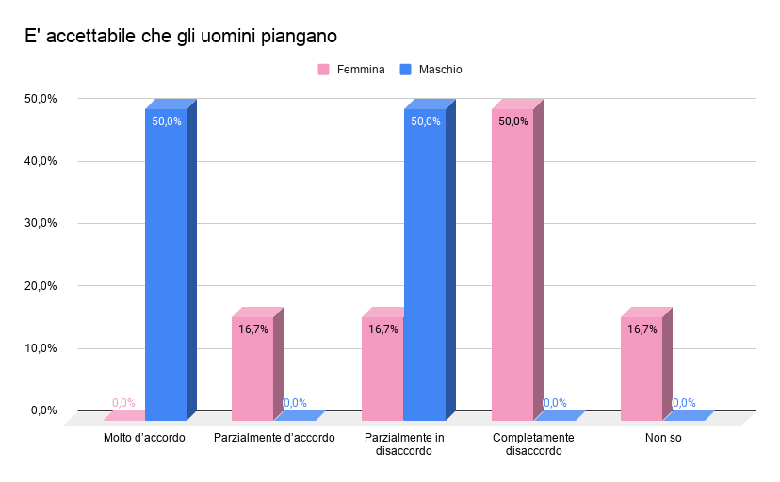
Some remark regarding gender stereotype: comparison between teachers and student
“It is acceptable for men to cry”
Female
Male
What the teachers think about the students’ answers

Slide 17
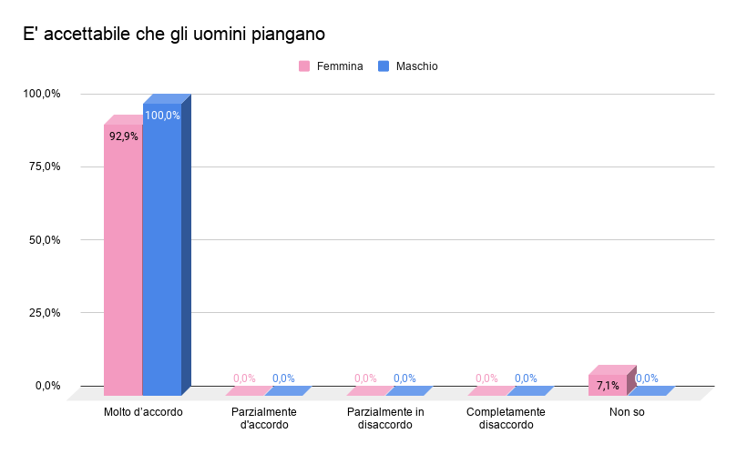
Some remark regarding gender stereotype: comparison between teachers and student
“It is acceptable for men to cry”
What the students answer

Slide 18
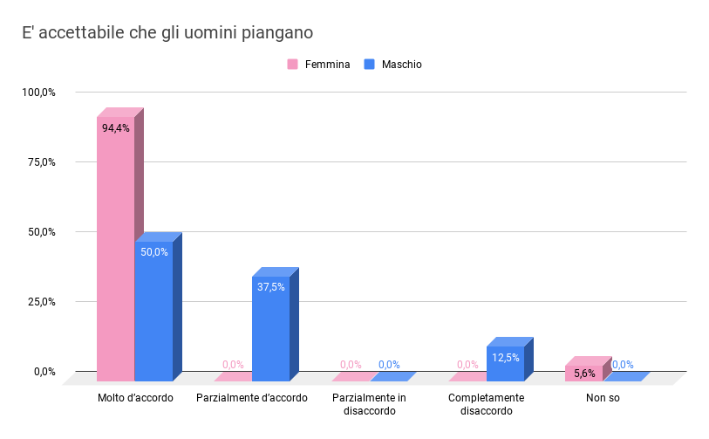
Some remarks regarding gender stereotype: comparison between parents and student
“It is acceptable for men to cry”
What the parents think

Slide 19
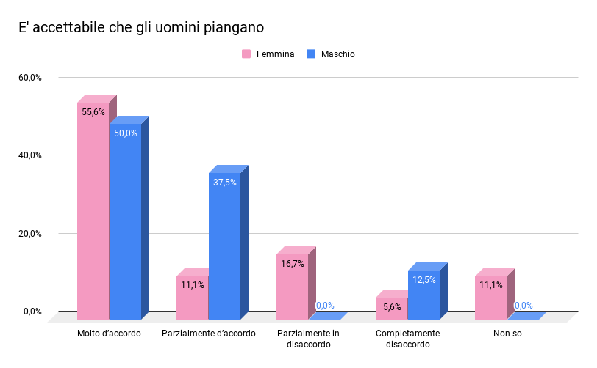

Some remark regarding gender stereotype: comparison between parents and students
“It is acceptable for men to cry”
Female
Male
What the parents think about the students’ answers

Slide 20
What we discussed with the students….
https://www.youtube.com/watch?v=B51RiajaIbY&feature=youtu.be
https://www.youtube.com/watch?v=B51RiajaIbY&feature=youtu.be

